Slide 1
Graphics and Animation
IN628 Intermediate Architectures and Algorithms
Semester 2, 2016
Notes:
Since we will be wanting animation in our roguelike, we will now start looking at how to implement it in C++.
This process will let us continue to develop our understanding of OO architecture, and will show examples of some new computational approaches.
We will begin with a very brief discussion of how animation works from a human cognition perspective, then we will consider the initial architecture of out animated character class. Over the next couple of weeks, we will add additional features to this class, to end up with what we need for our roguelike.

Slide 2
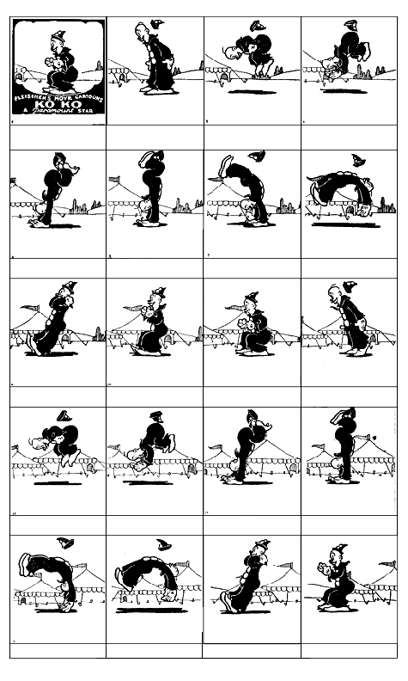
Animation
The production of the illusion of movement by rapid presentation of a series of still images.
Notes:
The basic physiology is of course the same
Works because of visual persistence (EXPLAIN)
Around in one form or another since the 17th century.

Slide 3
2D vs. 3D
2D: Presentation of a series of pre-rendered static images
Notes:
2d and 3d are completely different things
Note that 2D images may use perspective drawing techniques to appear three dimensional, but it is still 2D animation. Each individual image is flat and pre-rendered.

Slide 4
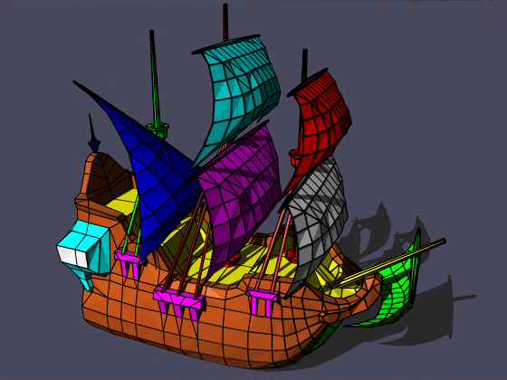
2D vs. 3D
3D: Images computed on the fly from mathematical models of the scene.
Notes:
Image is defined as a set of (x,y,z) vertices in a three dimensional coordinate space
The resulting planes are each assigned a colour
To update (e.g. move) the new location of each vertex is computed. Lots of maths required to do these transformation in three dimensions.
This determines the orientation of the planes (polygon)
Plane orientation combined with light source position determines the shade of each polygon or, in modern 3D, each pixel in each polygon.
The pixels are then drawn to the screen (called rendering).
More detail later in the term if people are interested?

Slide 5
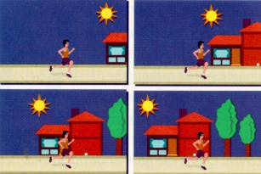
Frame-Based vs Cast-Based
Frame Based
alex.eled.duth.gr/.../ animatio/animbase.html
Notes:
Each image in the sequence is a single entity. Video is frame-based animation

Slide 6
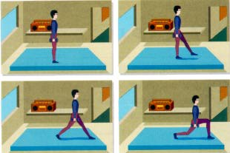
Frame-Based vs Cast-Based
Cast-Based
alex.eled.duth.gr/.../ animatio/animbase.html
Notes:
Objects in the scene, often called sprites, move independently of the background
Sprites can themselves be FrameBased
Later we’ll see that the backgrounds can be animated separately as well.
We will be doing cast-based animation. That is, our animated figured will move on top of a separate background.

Slide 7

Sprite Sheets
Notes:
Images for simple 2D animation come in blocks called sprite sheets
This is the Blobbo Sprite sheet
Sprites are generally square, so a sprite sheet is D pixels high by D*N pixels wide.
More complex animations can have more than one row of images, but we’ll start with this.
Observe that, if you drew each little square of Blobbo onto the screen in rapid succession, it would look like a moving Blobbo (he twists from side to side).
Sprite sheets usually have some very ugly background colour, like the fuchsia here. The method is to tell your rendering class to draw all the pixels from the spritesheet that aren’t the ugly background colour. Thus you can work with a convenient rectangular shape, but only the sprite itself shows.
This is called making the background transparent, but more accurately, it is simply not drawing the background pixels at all.
We will see how to do that with the .NET Graphics class in a bit.

Slide 8
Drawing From a Sprite Sheet
So far:
Image^ gnomeImage;
gnomeImage = Image::FromFile("gnome.jpg");
canvas->DrawImage(gnomeImage, xPos, yPos);
Notes:
We have been using instances of the Image class for drawing up until now.
We declared an Image^, initialised it with the static FromFile method, and displayed it on the screen by handing it off to canvas->DrawImage
We always used the whole image, and it drew all of its pixels (including background pixels that we didn’t really want --- recall the white areas around the gnomes…)

Slide 9
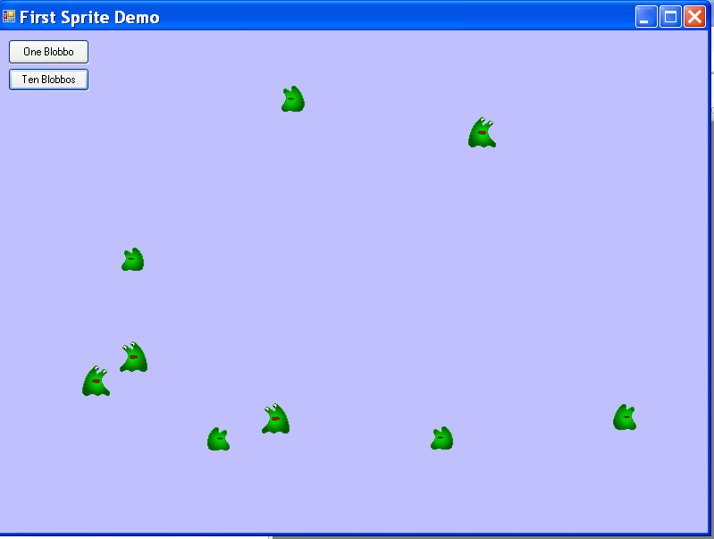
Drawing From a Sprite Sheet
Now we need to:
Draw only a portion of the pixels
Implement transparency
Notes:
The spritesheet image, however, contains many frames of the animation.
Now we need to draw a portion of the spritesheet image at a time.
Animation works by displaying the frames in turn, so we want to draw the first frame, then the second frame…
Here you see the blobbos appearing without their fucshia backgrounds (which we’ll discuss in a minute). Each blobbo has knows about the whole spritesheet with its 8 frames. Note how each of them is showing only a single frame-sized square from the whole spritesheet.

Slide 10
Drawing Part of an Image
DrawImage( Image^ sourceImage,
int xLoc, // on canvas
int yLoc, // on canvas
Rectangle sourceRectangle, // on source
GraphicsUnit unit);
Notes:
To draw only a portion of an image file, we use a more complex overload of DrawImage
Here is the function prototype for that method, from the definition of the Graphics class
Source image is the image object loaded up with the jpg of the whole spritesheet (all 8 frames).
xLoc and yLoc are still the upperLeft corner on the form
sourceRectangle describes which pixels of the image you want to draw. Rectangle is a primitive type that takes x,y,w,h.
You create them with the Rectangle constructor. Equivalent to what you have been doing with Point.
Graphics unit tell it the unit is pixels, not cm or em or something. We’ll see how to say this in a moment

Slide 11

Drawing Part of an Image
Notes:
Let’s see if we can draw just a portion of this very big image (it’s 1024 pixels wide).
Say starting at 1000,400 and being 200 wide and 200 high

Slide 12
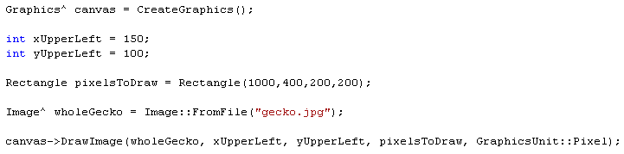
Drawing Part of an Image
Notes:
Note GraphicsUnit::Pixel. That is one of the .NET enum types. You will do this sort of thing a lot when working with .NET.
This will copy the area of the gecko image with upper left at 1000,400 and lower right at 1200,600.
It will draw those pixels at location 150,100 on the Form.

Slide 13
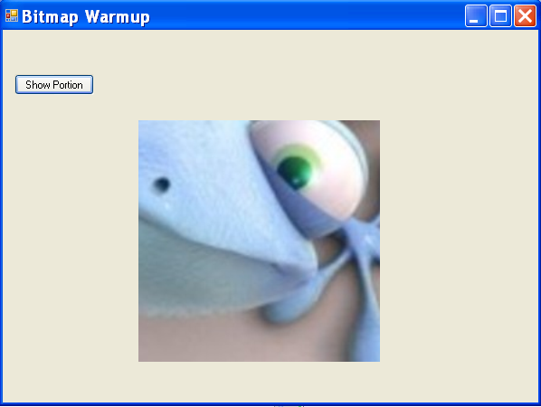
Drawing Part of an Image
Notes:
So the challenge is: How do you get your sprite to draw the correct pixels from his spritesheet?
Imagine you just wanted to make a simple animation loop that drew frame 1, then frame 2, then frame 3,…, to frame n, then started over.
How would you do it?
Assuming the sprite was staying in the same location, what would have to change in the call to Drawimage? => only the rectangle.
How would it change? => w, h, y would stay the same; x would increase by frame width each pass through the loop, and then wrap around to 0.
Let’s think about the logic and the maths

Slide 14
Using a SpriteSheet – Selecting Frames
Assume you know frameWidth and frameHeight
Assume the SpriteSheet has n frames (0 to n-1)
Frame | Rectangle to draw
0 | 0, 0, frameWidth, frameHeight
1 | frameWidth, 0, frameWidth, frameHeight
2 | 2* frameWidth, 0, frameWidth, frameHeight
3 | 3* frameWidth, 0, frameWidth, frameHeight
…
n-1 | (n-1) * frameWidth, 0, framewidth, frameHeight
Notes:
(Draw on board first)
For example, blobbo is 32 X 34 (frames are often square, but don’t have to be).
For reasons that will become clear, we think of the frames as being numbered from 0 to n-1, like the locations in an array
What are the pixel rectangles, in the coordinate space of the spriteSheet that we want to display?
(Work through on board first)
Note that the x-coordinate for the drawing rect is frameNumber * frameWidth. The first two are really 0*frameWidth and 1*frameWidth. (This is why we like to number our frame 0 to n-1).
Imagine we just wanted to draw Blobbo’s animation in a loop (in a button-click handler, say). It could look like this…

Slide 15
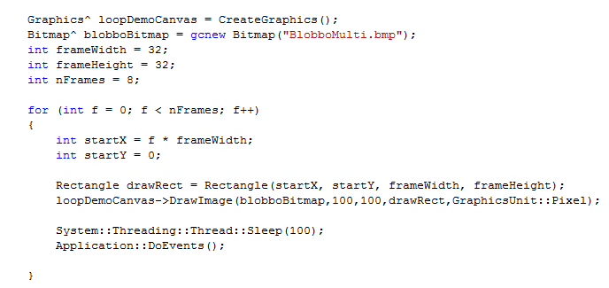
Using a SpriteSheet
Notes:
Talk through…
Here we are using the Bitmap class instead of Image. Note the different syntax for creation.
Bitmap is more powerful; we will need some of his special features later.
Now what if we want to add this behaviour to a Sprite class. We want our Sprite class to be able to draw itself.
Each time we call its draw method, we want to see the next frame

Slide 16
Sprite Class Animation
The class needs to know:
What Graphics^ it should draw to
Its spriteSheet image
Its frame dimensions
The frame it is currently on
The class needs to be able to:
Draw itself:
Compute the correct rectangle of pixels to display
Draw them to its Graphics^ object
Update its currentFrame
Notes:
We have seen why the class would need all that stuff…
We know how to do the computation: currentFrame * frameWidth, 0, frameWidth, frameHeight
But how does that “update” part work?

Slide 17
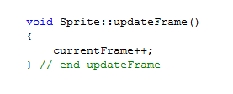
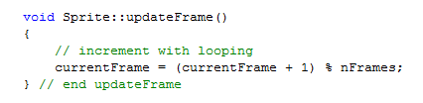
Updating currentFrame
Notes:
As long as we make currentFrame a class data member, we can update it in one method (updateFrame) and use it in another method (draw) with no problems.
This works great….for awhile
Assume that, like blobbo, you have 8 frames. 0, 1, 2,…7 is fine, but when you get to 8, you will be asking for a pixel position that is actually off the end of the spritesheet. (What do you think will happen? Try it. It’s fun.)
For a repeating animation like Blobbo’s we need to loop back around from n-1 to 0.
That is, 0, 1,…,6, 7, 0, 1, ….
Fortunately, this is exactly what the modulo operator does. Increment a value and take the mod n of that result and, when it reaches n, it loops back to 0 (Because the remainder of n/n = 0).
Questions:
Where, and to what, do we initialise currentFrame? In the ctor; to 0
Why do we make a separate method for updateFrame, rather than just add that code to Draw() => Because updating the frame is not part of drawing. We can easily imagine situations where we want to control drawing and updating separately. This is an OO thing: One Method, One Job.
How does animation happen? The consuming class must call Draw(), Update() in a loop. Also, possibly Erase() depending on the implementation. Or, you can provide a wrapper method that bundles them up.

Slide 18
Implementing Transparency
We can no longer use Image class
Must use Bitmap, a more complex descendent of Image.
Bitmap^ bob = gcnew Bitmap(“bobfile.jpg”);
Bimtaps have a method MakeTransparent
MakeTransparent accepts the transparent colour
When you draw a Bitmap instance, any pixels of the nominated transparent colour are not drawn.
Notes:
Finally, how to get rid of those background pixels?
Given the convention for backgrounds in 2D sprites, what colour do you need to know? => the colour of pixel 0,0.
Fortunately, bitmaps expose a GetPixel method that does exactly what you need here.
We’ll see examples of the syntax in the practical handout.

